Slide 1
Class/Object Relationships
Inheritance
CS(217) Object Oriented Programming

Slide 2
Inheritance (is-a) Non-inherited Members
Members that are not Inherited from base class are
  Constructors
  Destructor
  Assignment operator
  Non-member functions
Derived class constructors, destructor and assignment operators can call Base class constructors, destructor and assignment operators

Slide 3

Inheritance (is-a) Constructors in Derived Classes
Chain of constructor calls
  Derived-class constructor invokes base class constructor
    Implicitly by system default constructor
    Explicitly by programmer parametrized or copy constructor.
  Base of inheritance hierarchy
    Last constructor called in chain
    First constructor body to finish executing
  Initializing data members
    Each base-class constructor initializes its own data members
      Inherited by derived class

Slide 4
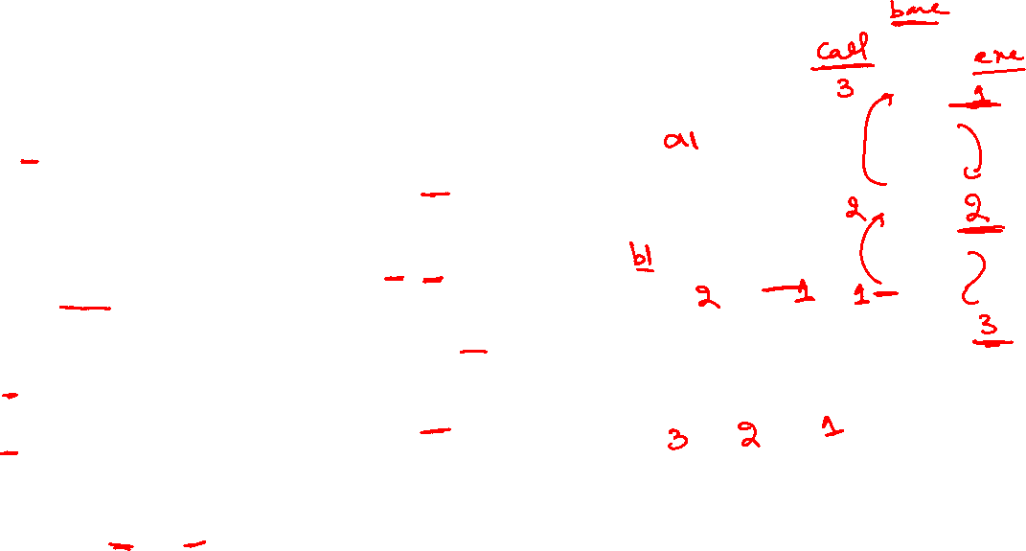
Inheritance (is-a) Default Constructors
A
class A{
  int a;
public:
  A(){ this->a=0;}
  void print(){ cout<<a;}
};
class B: public A{
  int b;
public:
  B(){ this->b = 0;}
};
class C: public B{
  int c;
public:
  C(){ this->c = 0;}
};
a=0
void main(){
  A a1;
  //A default constructor called
  B b1;
  //B’s and A’s default constructor is implicitly called by system
  C c1;
  //C’s, B’s and A’s default constructor is implicitly called by system
}
B
b=0
a=0
C
c=0
b=0
a=0

Slide 5
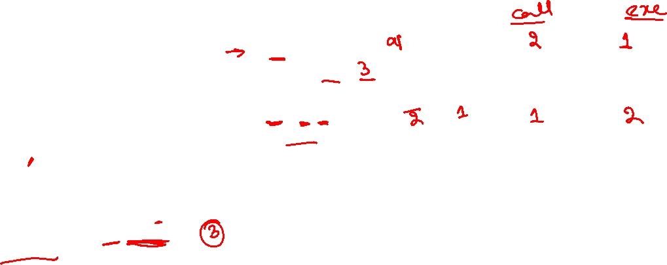
Inheritance (is-a) Parametrized Constructors
How to call specific constructors of base class?
class A{
  int a;
public:
  A(int a=0){ this->a=a;}
  void print(){ cout<<a;}
};
class B: public A{
  int b;
public:
  //call parametrized constructor of A
  B(int a=0, int b=0):A(a)
  { this->b = b;}
};
void main(){
  A a1(3);
  a1.print();
  B b1 (2,5);
  //Explicitly call parametrized constructor of B, A’s constructor is called by B.
}
Member initializer syntax used to call the parameterized constructor of base class
A
a=3
b=5
a=2
B

Slide 6
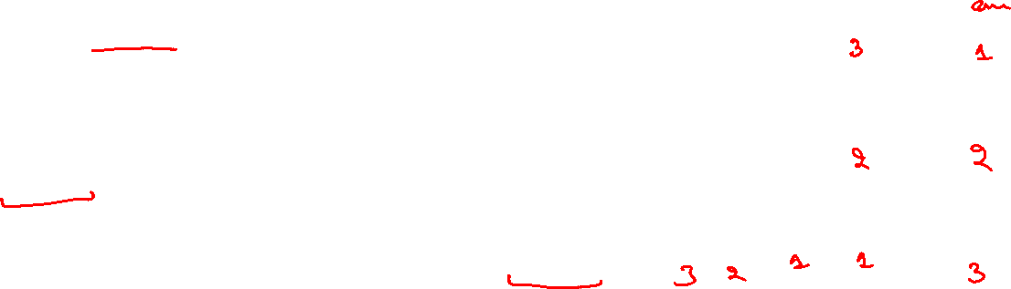
Inheritance (is-a) Parametrized Constructors
How to call specific constructors of base class?
a=3
class C: public B{
  int c;
public:
  //call parametrized constructor
  C(int a=0, int b=0, int c=0)
  :B(a,b)
  { this->c = c;}
};
void main(){
  A a1(3);
  a1.print();
  B b1 (2,5);
  // Explicitly call parametrized constructor of B, A’s constructor is called by B too.
  C c1 (2,5,11);
  // Explicitly call parametrized constructor of C, B’s constructor is called by C, and A’s constructor is called by B.
}
A
b=5
a=2
B
c=11
b=5
a=2
C

Slide 7
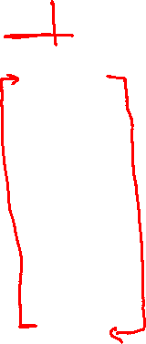
Inheritance (is-a) Constructors in Derived Classes
c=11
A
b=5
a=2
void main(){
  C c1 (2,5,11);
  //call parametrized constructor of C, B’s constructor is called by C, and A’s constructor is called by B.
}
Constructor Calling Implicit or Explicit:
1)C 2)B 3)A
Constructor Execution:
  in reverse order of inheritance from derived to base
1)A 2)B 3)C
B
C

Slide 8
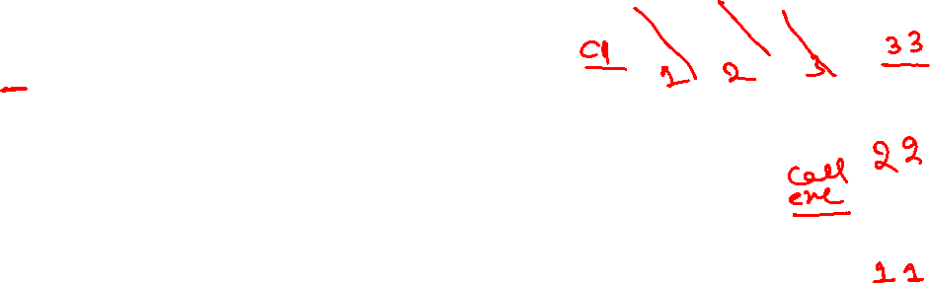
Inheritance (is-a) Destructor in Derived Classes
c=11
A
b=5
a=2
void main(){
  C c1 (2,5,11);
  //call parametrized constructor of C, B’s constructor is called by C, and A’s constructor is called by B.
}
Destructor Call and Execution:
  In reverse order of inheritance from derived to base
  First destroy derived objects then base inherited objects
  1)~C 2)~B 3)~A
B
C

Slide 9
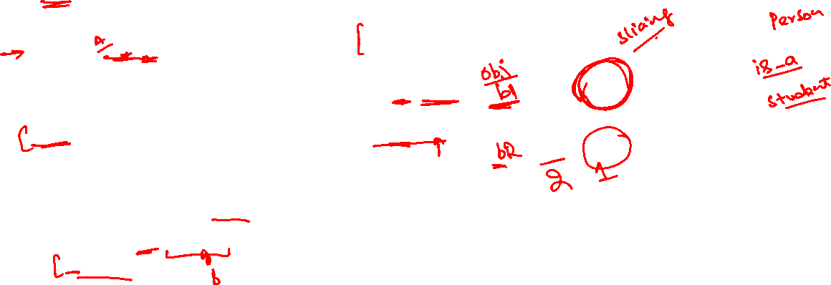
Inheritance (is-a) Copy Constructors
How to call specific constructors of base class?
class A{
  int a;
public:
  A(int a=0){ this->a=a;}
  A(const A& obj){ a = obj.a;}
  void print(){ cout<<a;}
};
class B: public A{
  int b;
public:
  //call parametrized constructor of A
  B(int a=0, int b=0):A(a)
  { this->b = b;}
  B(const B& obj):A(obj){
  b = obj.b;
  }
};
void main(){
  A a1(3);
  a1.print();
  B b1 (2,5);
  B b2 (b1);
  //Explicitly call copy constructor of B, A’s copy constructor is called by B.
}
A
a=3
b=5
a=2
B
b=5
a=2

Slide 10
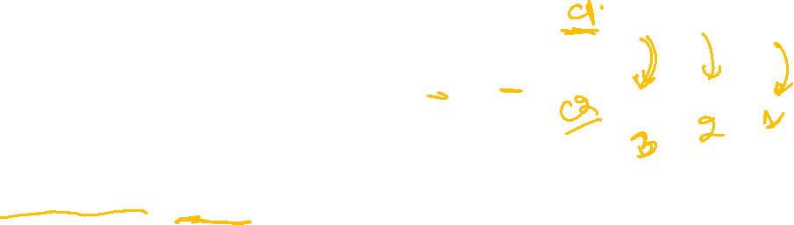
Inheritance (is-a) Copy Constructors
How to call specific constructors of base class?
void main(){
  C c1 (2,5,11);
  C c2 (c1);
  // Explicitly call copy constructor of C, B’s copy constructor is called by C, and A’s copy constructor is called by B.
}
class C: public B{
  int c;
public:
  //call parametrized constructor
  C(int a=0, int b=0, int c=0)
  :B(a,b)
  { this->c = c;}
  C(const C& obj):B(obj){
  c = obj.c;
  }
};
c=11
A
b=5
a=2
c=11
b=5
a=2
B
C

Slide 11

Inheritance (is-a) Function Overriding
Many Inherited functions may have limited functionality related to base class members only
Need to add more instructions in functions for derived class
Redefining inherited function in derived class with
  Same Name
  Same number, type, and order of parameters.
is called function overriding.

Slide 12
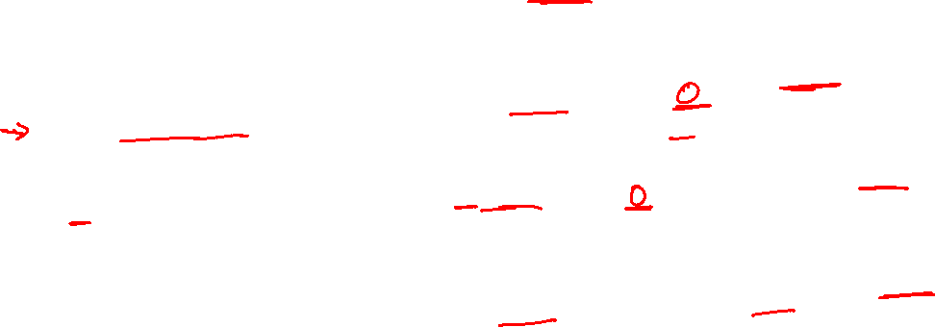
Inheritance (is-a) Function Overriding
A
class A{
  int a;
public:
  A(int a=0){ this->a=a;}
  void print(){ cout<<a;}
};
class B: public A{
  int b;
public:
  B(int a=0, int b=0):A(a)
  { this->b = b;}
};
class C: public B{
  int c;
public:
  C(int a=0, int b=0, int c=0) :B(a,b)
  { this->c = c;}
};
a=0
void main(){
  A a1;
  a1.print();
  //Base print called prints a’s data
  B b1;
  b1.print();
  //inherited print of A is called
  print a’s data not b’s
  C c1;
  c1.print();
  //inherited print of A is called
  print a’s data not of c and b
  }
Base class function is limited to its members printing only.
B
b=0
a=0
C
c=0
b=0
a=0

Slide 13
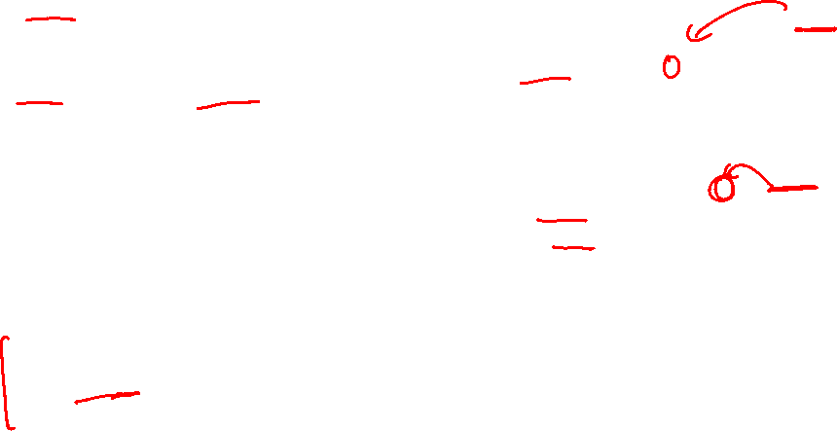
Inheritance (is-a) Function Overriding
A
class A{
  int a;
public:
  A(int a=0){ this->a=a;}
  void print(){ cout<<a;}
};
class B: public A{
  int b;
public:
  B(int a=0, int b=0):A(a)
  { this->b = b;}
  //override print function inherited from A
  void print(){
  cout<<b;
  }
};
a=0
void main(){
  A a1;
  a1.print();
  //Base print called print a’s data
  B b1;
  b1.print();
  //overridden function called print b’s data only not a’s
  }
Redefine code only no change in function name and parameters.
B
b=0
C
a=0

Slide 14
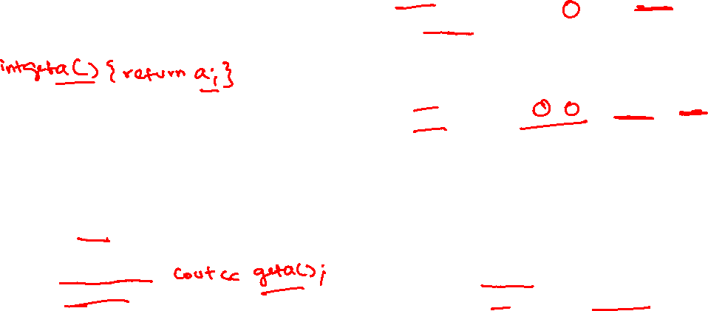
Inheritance (is-a) Function Overriding
A
class A{
  int a;
public:
  A(int a=0){ this->a=a;}
  void print(){ cout<<a;}
};
class B: public A{
  int b;
public:
B(int a=0, int b=0):A(a){this->b = b;}
//override inherited function from A
  void print(){
//calls base class print A::print();
  cout<<b;
  }
};
void main(){
  A a1;
  a1.print();
  //Base print called print a’s data
  B b1;
  b1.print();
  //overridden function called, first calls A’s print to print a’s data then print b’s data
  }
Can call inherited function of base class.
  Name of base class, scope resolution operator :: , name of function
a=0
B
b=0
a=0
C

Slide 15
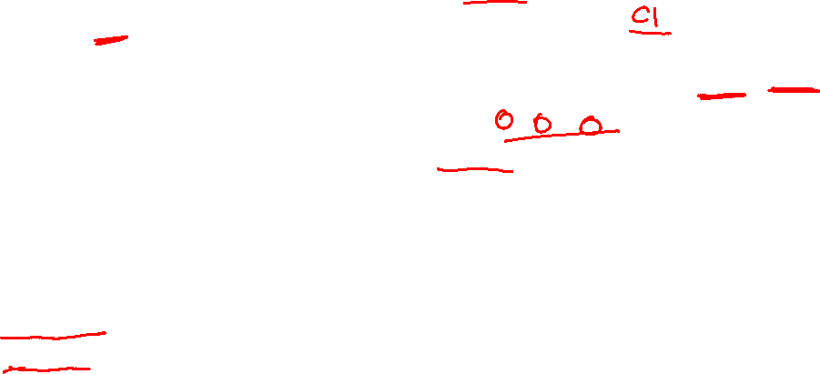
Inheritance (is-a) Function Overriding
A
class C: public B{
  int c;
public:
  C(int a=0, int b=0, int c=0) :B(a,b)
  { this->c = c;}
//override print function inherited from B
  void print(){
//calls base class print for base class data
  B::print();
  cout<<c;
  }
};
c=0
void main(){
  C c1;
  c1.print();
  //overridden function called, first calls B’s print to print B’s data
  then print c’s data
  }
b=0
a=0
B
C

Slide 16

Inheritance (is-a) Function Overloading
Can overload base class inherited function in derived class to add some functionality
Overload function with
  Same Name
  Change parameters type, number or order

Slide 17
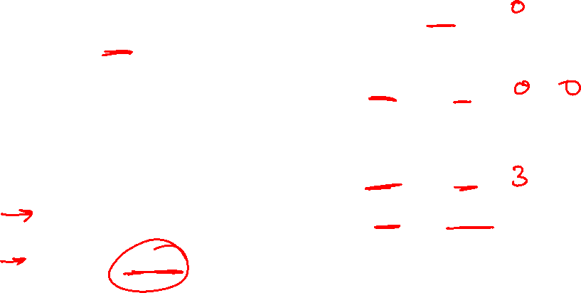
Inheritance (is-a) Function Overloading
A
class A{
  int a;
public:
  A(int a=0){ this->a=a;}
  void print(){ cout<<a;}
};
class B: public A{
  int b;
public:
B(int a=0, int b=0):A(a) { this->b = b;}
//override inherited function from A
  void print(){ A::print(); cout<<b; }
//overload inherited function from A
  void print(int x){ cout<<x+b; }
};
a=0
void main(){
  A a1;
  a1.print();
  //Base print called print a’s data
  B b1;
  b1.print();
  //overridden function called, first calls A’s print to print a’s data then print b’s data
  b1.print(3);
  //overloaded function called
  a1.print(10);
  //overloaded function is not part of base class error
  }
B
b=0
a=0
C

Slide 18
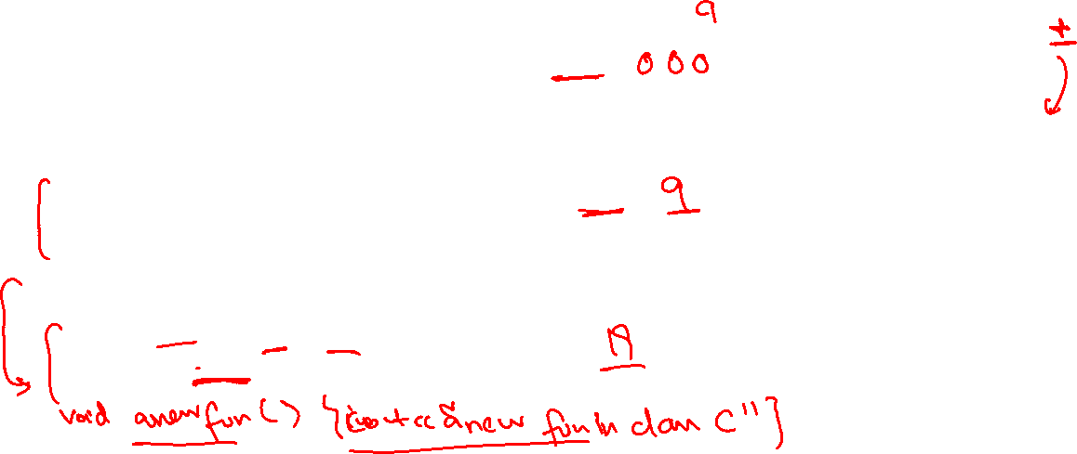
Inheritance (is-a) Function Overloading
A
class C: public B{
  int c;
public:
  C(int a=0, int b=0, int c=0) :B(a,b)
  { this->c = c;}
//override inherited function from B
  void print(){
  B::print();
  cout<<c;
  }
//overload inherited function from B
  void print(int x, int y){
  cout<<x+y+c;
  }
};
void main(){
  C c1;
  c1.print();
  //overridden function called, first calls B’s print to print B’s data
  then print c’s data
  c1.print(9);
  //inherited function of B is called
  c1.print(9, 10);
  //overloaded function called
  //overloaded function is not part of B and A class
  }
c=0
B
b=0
a=0
C

